Slide 1
Introducing iSCSI Protocol on Online Based MapReduce Mechanism
Since the beginning of creation humans have valued data and time
International Conference On Computational Science and Its Application, ICCSA-2014
Guimaraes, Portugal.
Presented By
Sung-Soon Park

Slide 2
Contents
Introduction
Motivation
Proposed Schemes
Experiments and Result Analysis
Conclusion

Slide 3




Introduction (1/4)
Big data is a collection of huge amount of data sets. Data can be classified into three types:
  Structured data: processed by NoSQL, MongoDB, and TerraStore
  Unstructured data
  Semi-structured data
It will be better if MapReduce take little time to process the huge amount of data. Our goal is to optimize MapReduce.
Notes:
Structured data can be processed by NoSQL, MongoDB, TerraStore but the other two types of data are not possible to process in this way. Google introduced Mapreduce mechanism which can process that kind of data.
Now a days facebook, yahoo use MapReduce to process their huge amount of data.
It will be better if MapReduce take little time to process the huge amount of data so our goal is to optimize MapReduce.
That will reduce the completion time of processing big data.

Slide 4
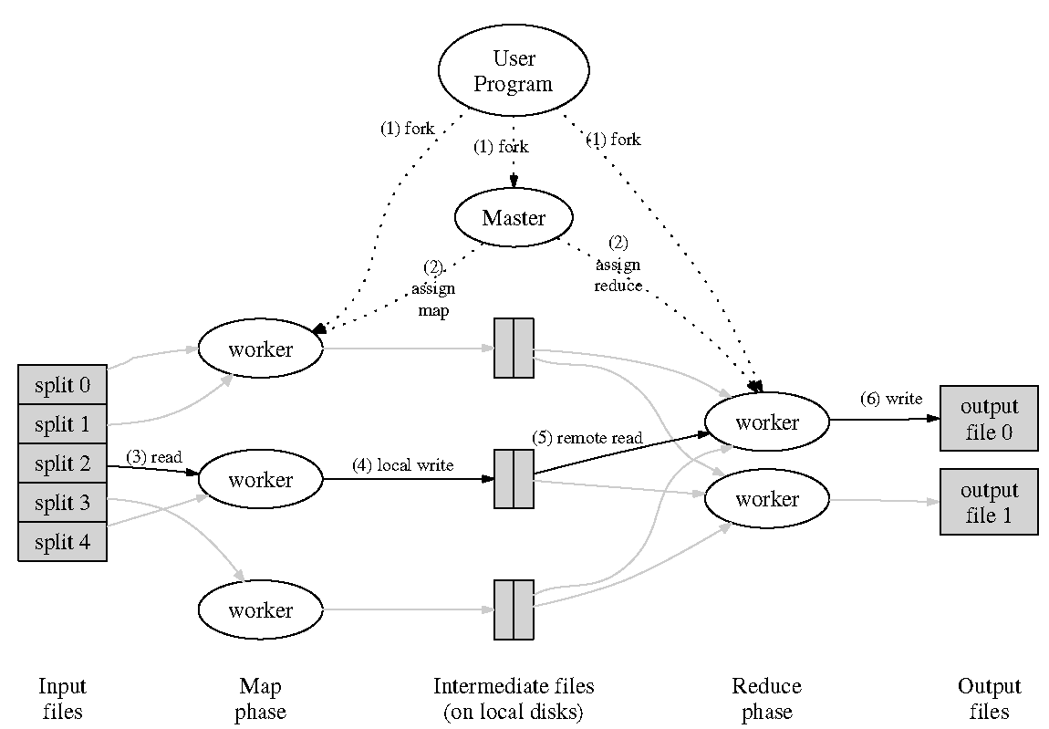
Introduction (2/4)
MapReduce Architecture
Notes:
MapReduce is a programming model for processing large data sets with a parallel, distributed algorithm on a cluster.
This model is consist of Map and Reduce functions.
At first, Master accept jobs from clients and divide those jobs into split tasks(64 Mb or 128 MB or 256 MB….).
Finally Master assign those tasks execution by worker nodes into Map phase and reduce phase.
Map Phase: The map phase reads the task’s split and it generates (key, value) pairs.
After completing all task, it send output to reduce phase and create a connection between map to reduce phase to sent data.
Reduce Phase: After getting all output of map phase, the reduce phase shuffle those output as (key, value) pairs and after that it reduce same key.
Finally, the output of reduce function is stored in HDFS.

Slide 5
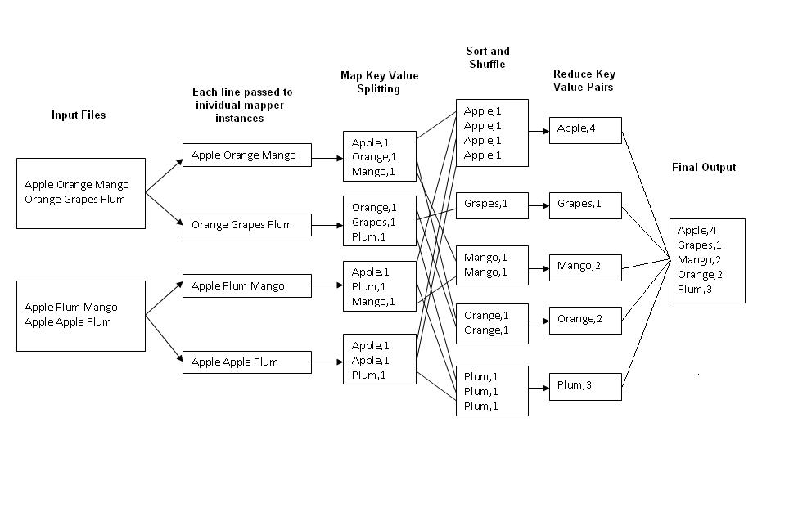
Introduction (3/4)
MapReduce Example
Notes:
This is an example of working procedure of MapReduce mechanism.
Here we can see that two input files are divided into four split task.
In Map Phase, it generates (key, value) pair [ such as in first split task here amount of apple is 1, orange is 1 and mango is 1].
Here same procedure continue for all split task.
Finally, complete all task in map phase then reduce task start to work.
In reduce phase, at first it, shuffle as same key such as apple, grapes, mango, orange, plum and reduce all same (key, value) pairs.

Slide 6
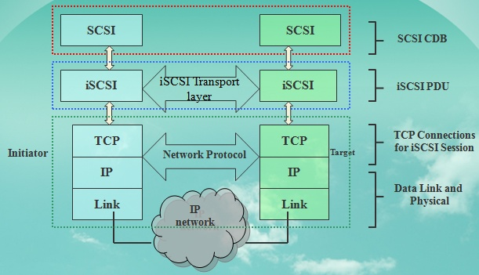
Introduction (4/4)
Problems of MapReduce:
Reducer waits for full completion of Map task
Data overload and connection problem
Time of completion
Solution: Introducing iSCSI protocol
Notes:
In traditional MapReduce mechanism:
we can see that reducer wait for long time until mapper complete its whole task.
and, they used TCP to create connection between map and reduce phase.
But, there are some problem occurred related data transmission, TCP Congestion.
that’s why we introduce iSCSI protocol.[Here we motivated for our iSCSI multi-connection mechanism, parameter optimization ]

Slide 7
Motivation
In pipelining mechanism[ref], they used naïve implementation to send data directly from map to reduce tasks: MapReduce
Big Data transition Map to Reduce process by using TCP: occur data overload and connection problem.
Then, Map task retransmit the whole data.
It has no mechanism to handle data overload
MRA [MapReduce Agent]
Transmit data without retransmission
Has a mechanism to handle data overload
[ref: Tyson Condie, Neil Conway, Peter Alvaro, Joseph M. Hellerstein UC Berkeley: MapReduce Online. Khaled Elmeleegy, Russell Sears(Yahoo! Research)2012 ]
Notes:
The current online based MapReduce mechanism:
use TCP socket to send data from map to reduce task.
They deal with big data, so data overload may occur and that will cause connection problem.
When connection problem occur, map task retransmit the whole data which is time consuming.
Moreover, recent MapReduce has no mechanism to handle data overload.
So, we motivated to solve those problems and create a new mechanism to transmit data, that is MapReduce Agent(MRA) which can transmit data without retransmission and also have a mechanism to handle data overload.

Slide 8
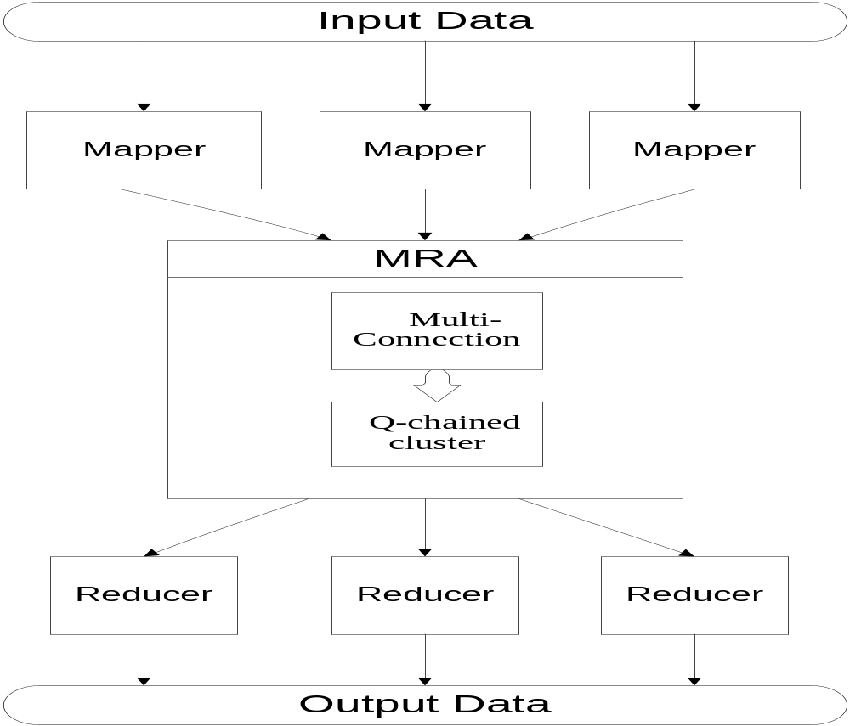
Proposed Model (1/3)
  MapReduce Agent(MRA)
Notes:
This is our proposed model that is MapReduce Agent(MRA) and,
it consist of Multi-connection and ErrorRecovery Method of iSCSI to create connection between map to reduce phase and
Q-Chained cluster to balance data overload at the time of data transmission.

Slide 9
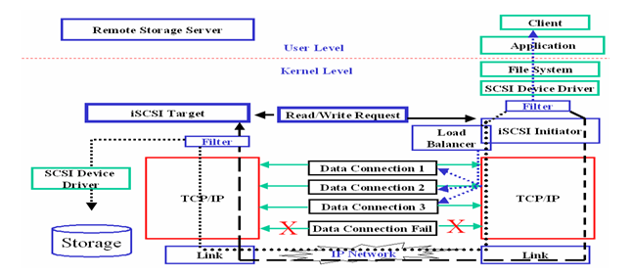
Proposed Model (2/3)
Overview of Multi-connection and ErrorRecovery Method of iSCSI
[ref: S.M.Allayear, Sung Soon Park: iSCSI Multi-Connection and Error Recovery Method for Remote Storage System in Mobile Appliance. The 2006 International Conference on Computational and It’s Applications (ICCSA2006), Glasgow- Scotland. Springer-Verlag Berlin Heidelberg 2006, (SCI Indexed) LNCS 3981, pp.641-650.
Notes:
Here we can see that If packet losses occur due to bad channel characteristics in data connection 3 ,
Our Proposed multi-connection method will randomly pick out another data connection opened during an iSCSI service session except loss connection.
By using Q-Chained cluster, data are balanced among active data connection.

Slide 10
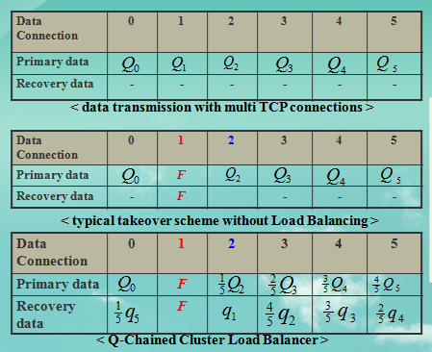
Proposed Model (3/3)
  Q-Chained Load Balancer:
  Being able to fully balance, the workload among the data connections in the event of packet losses due to bad channel characteristics.
Notes:
Being able to fully balance, the workload among the data connections in the event of packet losses due to bad channel characteristics.

Slide 11
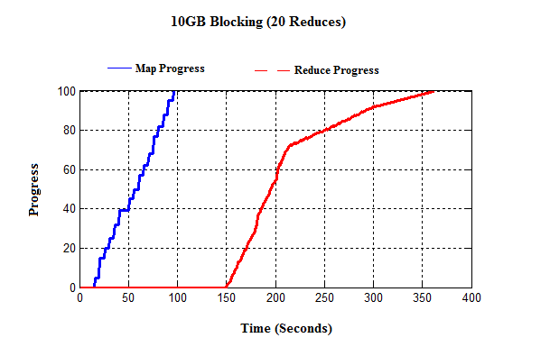
Performance Evaluation (1/6)
10 GB Blocking
CDF of map and reduce task completion times for a 10GB wordcount job using 20 map tasks and 20 reduce tasks (512MB block size).
The total job runtimes were 361 seconds for blocking.
Notes:
In blocking mechanism, after completing map task, reduce task start to work.
That’s why in this mechanism to process big data the total job runtime were more.

Slide 12
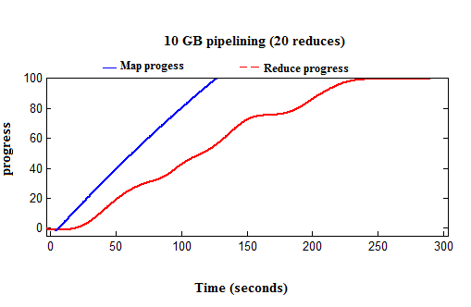
Performance Evaluation (2/6)
10 GB pipelining
CDF of map and reduce task completion times for a 10GB wordcount job using 20 map tasks and 20 reduce tasks (512MB block size).
The total job runtimes were 290 seconds for pipelining.
Notes:
In pipelining mechanism, reduce task start to work after each record is generated, that’s why the total job runtime were less than blocking.
In this mechanism, they used TCP to create connection between map to reduce task.
If any connection problem occurred than map task retransmit whole data.

Slide 13
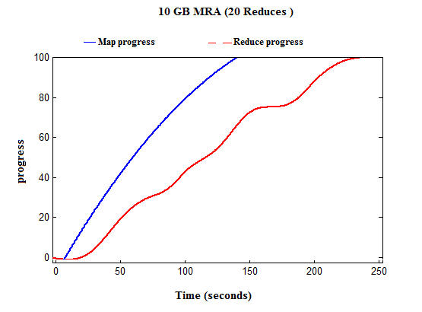
Performance Evaluation (3/6)
10 GB MRA
CDF of map and reduce task completion times for a 10GB wordcount job using 20 map tasks and 20 reduce tasks (512MB block size).
The total job runtimes were 240 seconds for MRA.
Notes:
In our MRA mechanism, reduce task start to work after each record is generated, that’s why the total job runtime were less than blocking and pipelining.
Because of in pipelining mechanism, If any connection problem occurred than map task retransmit whole data.
Our MRA can transmit data without retransmission if any connection problem occurred.
So our MRA can reduce completion time.

Slide 14
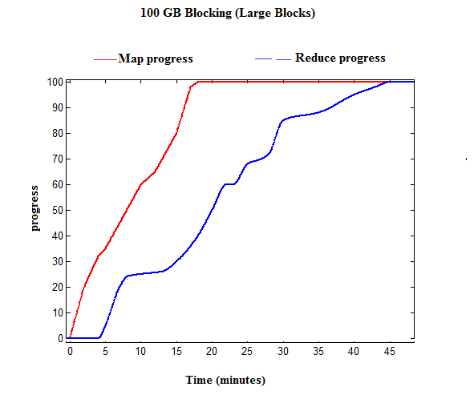
Performance Evaluation (4/6)
  100 GB Blocking
  CDF of map and reduce task completion times for a 100GB wordcount job using 240 map tasks and 60 reduce tasks (512MB block size).
  The total job runtimes were 48 minutes for blocking.

Slide 15
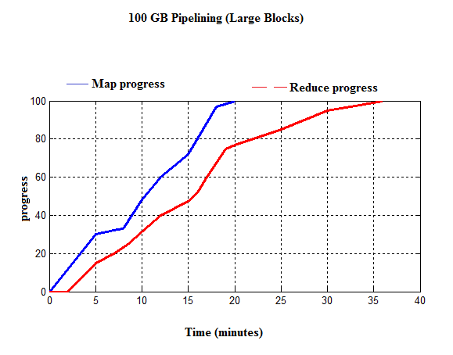
Performance Evaluation (5/6)
  100 GB pipelining
  CDF of map and reduce task completion times for a 100GB wordcount job using 240 map tasks and 60 reduce tasks (512MB block size).
  The total job runtimes were 36 minutes for pipelining.

Slide 16
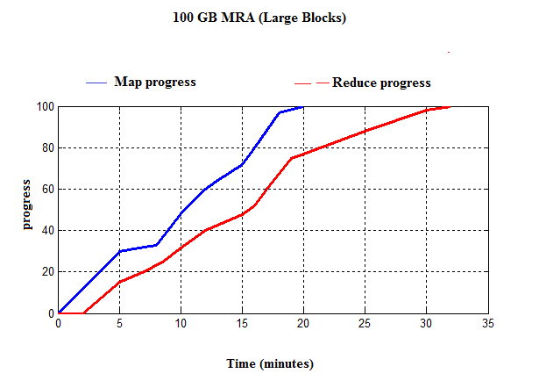
Performance Evaluation (6/6)
  100 GB MRA
CDF of map and reduce task completion times for a 100GB wordcount job using 240 map tasks and 60 reduce tasks (512MB block size).
The total job runtimes were 32 minutes for MRA.

Slide 17
Conclusion
In these circumstances, our proposed mechanism (MRA) may prove its better time completion for Hadoop technique.
Now a days Hadoop technique is used in facebook, yahoo,
cloud computing.
So, our research can play an important role in the distributed file system and network storage area.

Slide 18
Reference
DEAN, J., AND GHEMAWAT, S. MapReduce: Simplified dataprocessing on large clusters. In OSDI (2004).
SAM-3 Information Technology – SCSI Architecture Model 3, Working Draft, T10 Project 1561-D, Revision7, 2003.
S.M.Allayear, Sung Soon Park: iSCSI Multi-Connection and Error Recovery Method for Remote Storage System in Mobile Appliance. The 2006 International Conference on Computational and It’s Applications (ICCSA2006), Glasgow- Scotland. Springer-Verlag Berlin Heidelberg 2006, (SCI Indexed) LNCS 3981, pp.641-650.
Tyson Condie, Neil Conway, Peter Alvaro, Joseph M. Hellerstein UC Berkeley: MapReduce Online. Khaled Elmeleegy, Russell Sears(Yahoo! Research)
HELLERSTEIN, J. M., HAAS, P. J., AND WANG, H. J. Online aggregation. In SIGMOD (1997).

